Slide 1
Parallel and Distributed Computing
Priyal Chaudhari
Prashant Vikram Singh
Under the guidance of Prof. Srikanth Krishnamurthy

Slide 2
Parallel Computing
Parallel computing is a type of computation in which many calculations or the execution of processes are carried out simultaneously.
Large problems can often be divided into smaller ones, which can then be solved at the same time.
Types of parallel computing:
Bit-Level
Instruction-Level
Task Parallel
Data Parallel

Slide 3
Distributed Computing
A distributed system is a model in which components located on networked computers communicate and coordinate their actions by passing messages
The components interact with each other in order to achieve a common goal.
Three significant characteristics of distributed systems are:
concurrency of components,
lack of a global clock
independent failure of components
Examples of distributed systems vary from SOA-based systems to massively multiplayer online games to peer-to-peer applications

Slide 4
Task Parallel
Task parallelism (also known as function parallelism and control parallelism) is a form of parallelization of computer code across multiple processors in parallel computing environments.
Task parallelism focuses on distributing tasks—concurrently performed by processes or threads—across different processors
The simple pseudocode for Task Parallelism is as:
if CPU="a" then
do task "A“
else if CPU="b" then
do task "B“
end if

Slide 5
Data Parallel
Data parallelism is a form of parallelization across multiple processors in parallel computing environments.
It focuses on distributing the data across different nodes, which operate on the data in parallel. It can be applied on regular data structures like arrays and matrices by working on each element in parallel
The simple pseudocode for Task Parallelism is as:
if CPU = "a"
lower_limit := 1
upper_limit := round(d.length/2)
else if CPU = "b"
lower_limit := round(d.length/2) + 1
upper_limit := d.length
for i from lower_limit to upper_limit by 1
foo(d[i])

Slide 6
Data Parallel vs Task Parallel
Data Parallelism | Task Parallelism
Same operations are performed on different subsets of same data. | Different operations are performed on the same or different data.
Synchronous computation | Asynchronous computation
Speedup is more as there is only one execution thread operating on all sets of data. | Speedup is less as each processor will execute a different thread or process on the same or different set of data.
Amount of parallelization is proportional to the input data size. | Amount of parallelization is proportional to the number of independent tasks to be performed.
Designed for optimum load balance on multi processor system. | Load balancing depends on the availability of the hardware and scheduling algorithms like static and dynamic scheduling.
Data parallelism emphasizes the distributed (parallel) nature of the data, as opposed to the processing (task parallelism).
Most real programs fall somewhere on a continuum between task parallelism and data parallelism.

Slide 7
Parallelization and Distribution Demo
Libraries required:
Multiprocessing
ipyparallel
Demo ipython files are present under the folders:
parallel
parallel&distributed

Slide 8
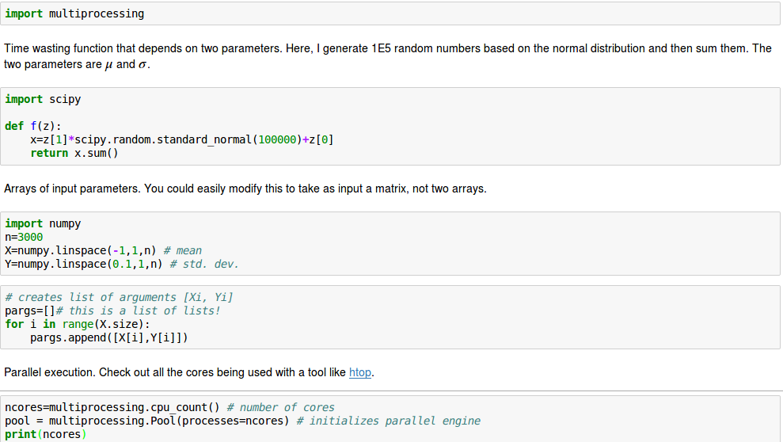
Sample code for Parallelization and Distribution

Slide 9
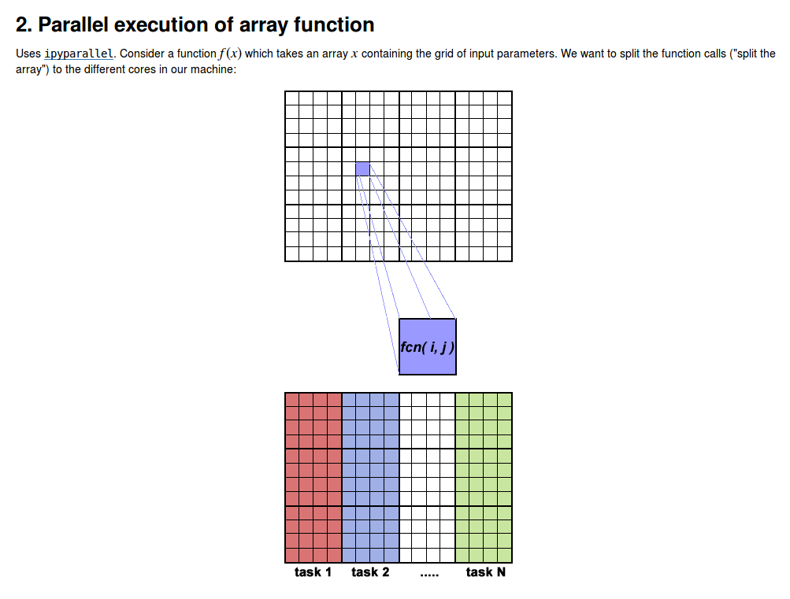

Slide 10
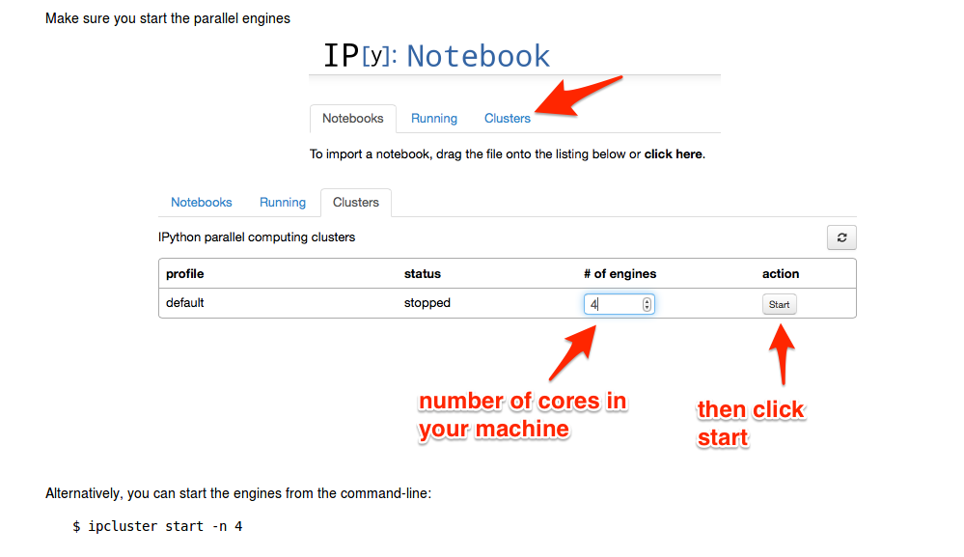

Slide 11
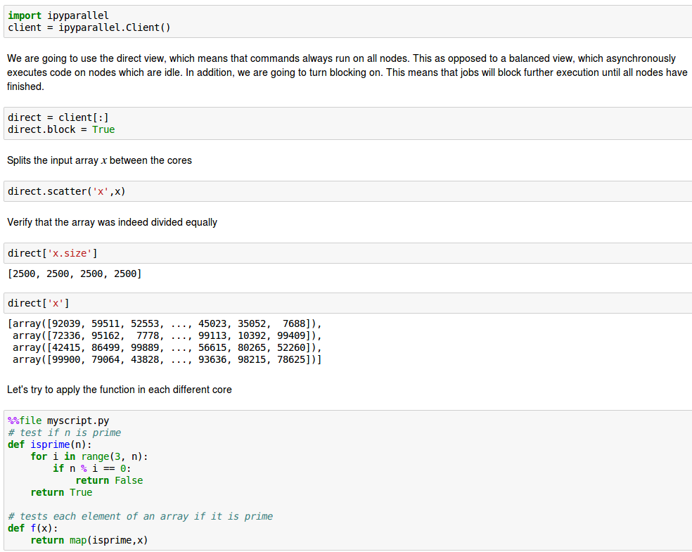

Slide 12
GPU (Graphics Processing Unit)
A graphics processing unit (GPU) is a specialized electronic circuit designed to rapidly manipulate and alter memory to accelerate the creation of images in a frame buffer intended for output to a display device.
GPU Power

Slide 13
Need of GPGPU
General-purpose computing on graphics processing units (GPGPU) is the use of a graphics processing unit (GPU), which typically handles computation only for computer graphics, to perform computation in applications traditionally handled by the central processing unit (CPU)
Computational requirements are large
Parallelism is substantial
Throughput is more important than latency

Slide 14
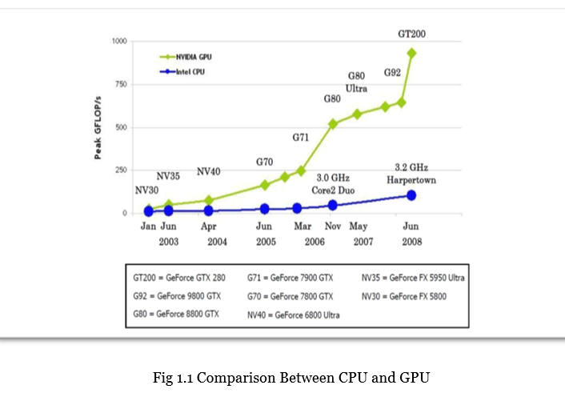
Difference between CPU and GPU

Slide 15
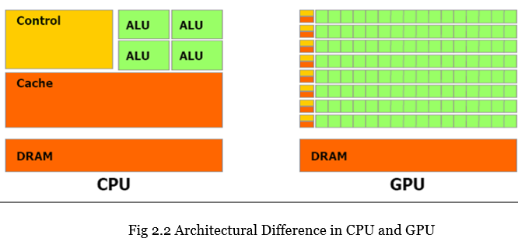
Architectural Difference between CPU and GPU

Slide 16
GPU Demo
Libraries Required:
pylab
numba
numbapro
Demo ipython file is present under the folder:
GPU

Slide 17
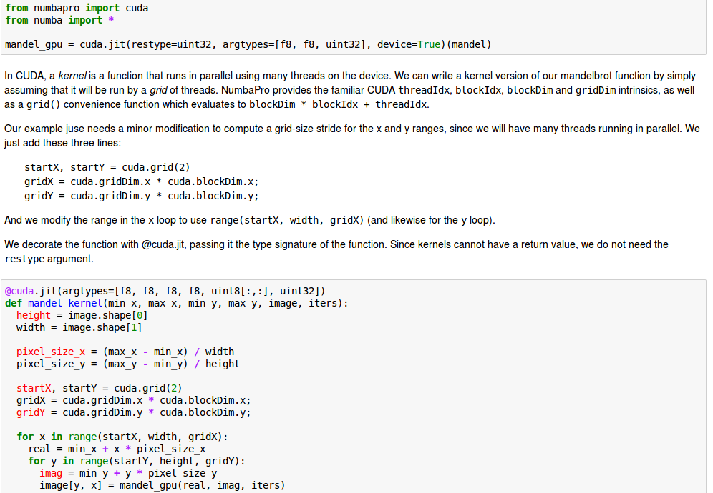
Sample Code for GPU

Slide 18
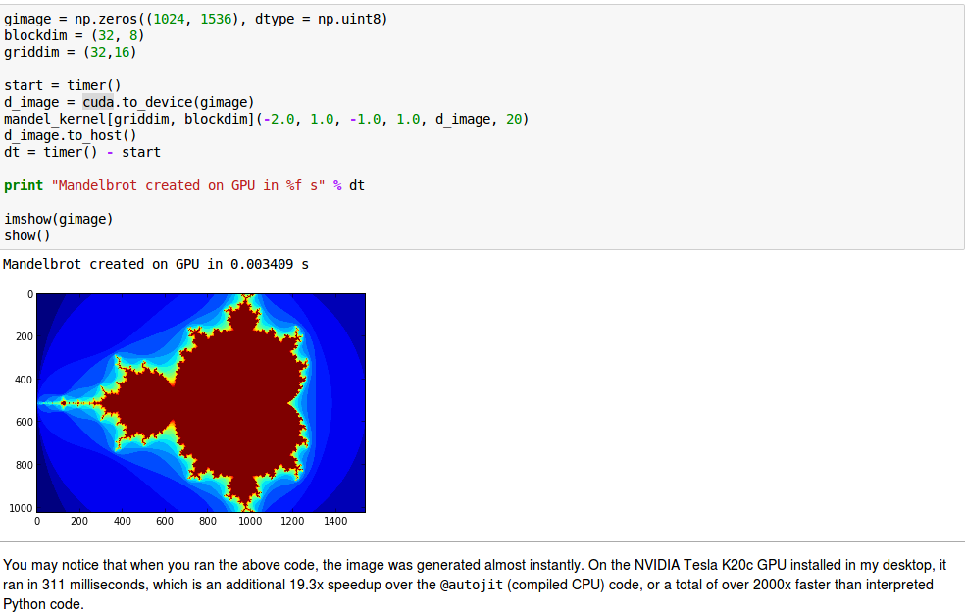

Slide 19
Disadvantages of using GPU
Relationship to other parallel hardware and software
Managing rapid change
Performance evaluation and cliffs
Philosophy of faults and lack of precision
Broader toolbox for computation and data structures
Wedding graphics and GPU computing

Slide 20
Parallel & Distributed computing Use Cases
Use Case 1
Record processing is a common computing problem that enterprises have to deal with. Telco companies, for instance, take the information from the calls their customers make, process the data by following some specific rules, and then draw useful conclusions and thus obtain valuable business knowledge. The transformation usually takes a lot of time and requires a considerable amount of computing resources.

Slide 21
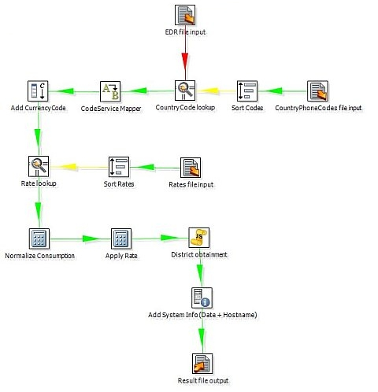

Slide 22
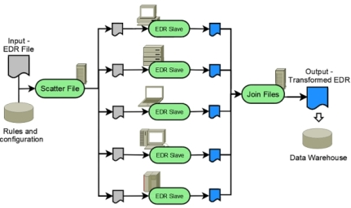
Using GridCOMP, we distribute the transformation effort, so EDR processing can be computed in parallel among the existing computational resources. The application receives a sequential file containing the Extended Data Records as fixed length fields. The input file is split into chunks and distributed to the nodes on the grid. Each node processes its corresponding chunk, generating a partial result file that is transferred back to the application. In the end, the partial results are joined into the final result file.

Slide 23
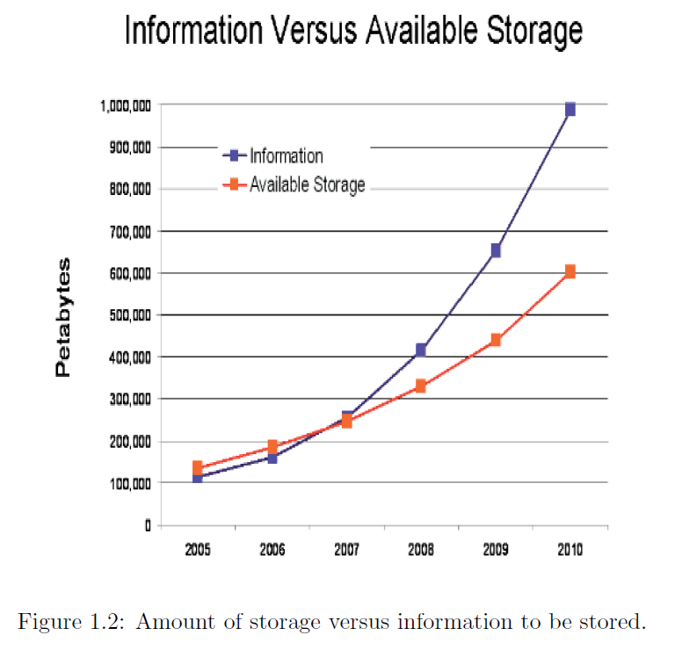
Use Case 2
There is another real world problem of Data Duplication.

Slide 24
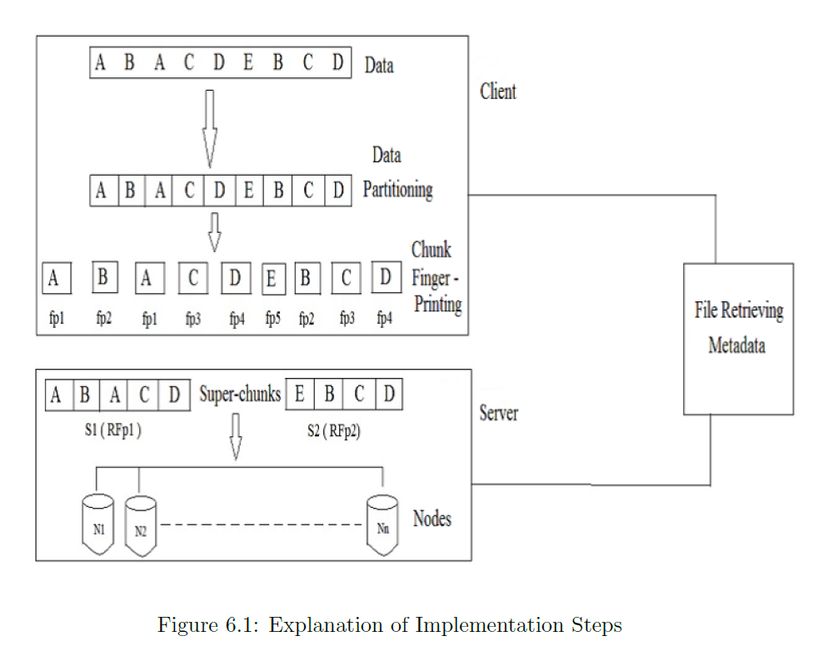
Data Deduplication process can be used to tackle Data Duplication

Slide 25
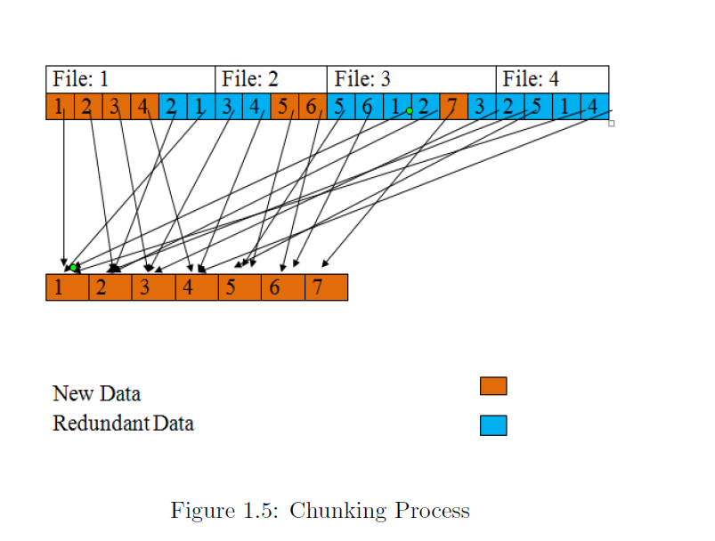
We can use parallel and distributed computing concept to make this process faster by splitting the incoming file into chucks and routing each chunk based on their similarity index.

Slide 26
Thank You!

